Slide 1
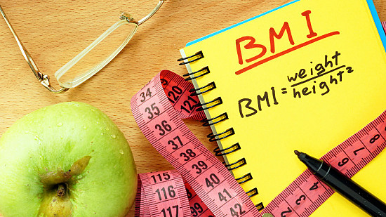
Smart BMI Calculator
By: Excellence Sowunmi
Advisor : Dr Mahbub Mishu

Slide 2

Insite on the project.
Implemented technology.
Display a DEMO
Lessons learnt.
Alterations that could be made
Future Plans

Slide 3
Project Introduction
Developed a sophisticated body mass index (BMI) system.
A smart BMI system can track your height and has other features that may be used for health.
Used photograph taken through a camera lens to calculate the user's height, weight, and result.
Include a field to enter an age and a calculation to see if your BMI is appropriate for the age group.
Notes:
Developed a sophisticated body mass index (BMI) system.
A smart BMI system can track your height and has other features that may be used for your health in more complex situations, so everyone, regardless of their vocation, can benefit from it.
In my version, I'll use a photograph taken through a camera lens to calculate the user's height, weight, and final result.
Moreover, I'd like to include a field for you to enter your age and a calculation to see if your BMI is appropriate for your age group.

Slide 4



Implemented Technology
Python
Tkinter
Rembg
Cv2
Haar-Cascade Face Detection Algorithm

Slide 5
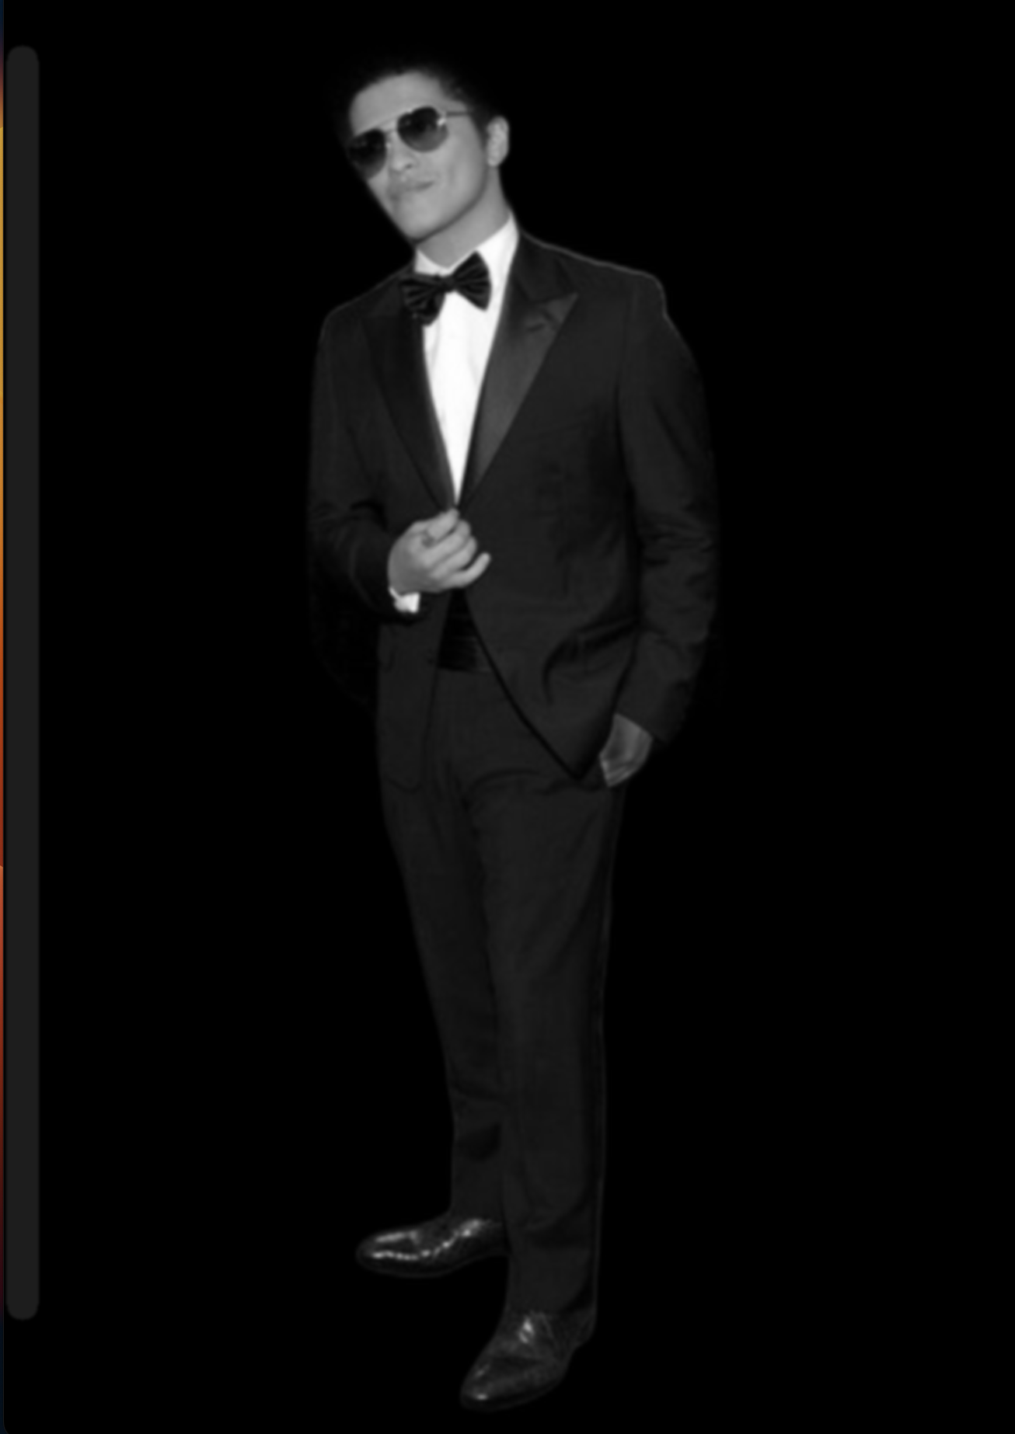
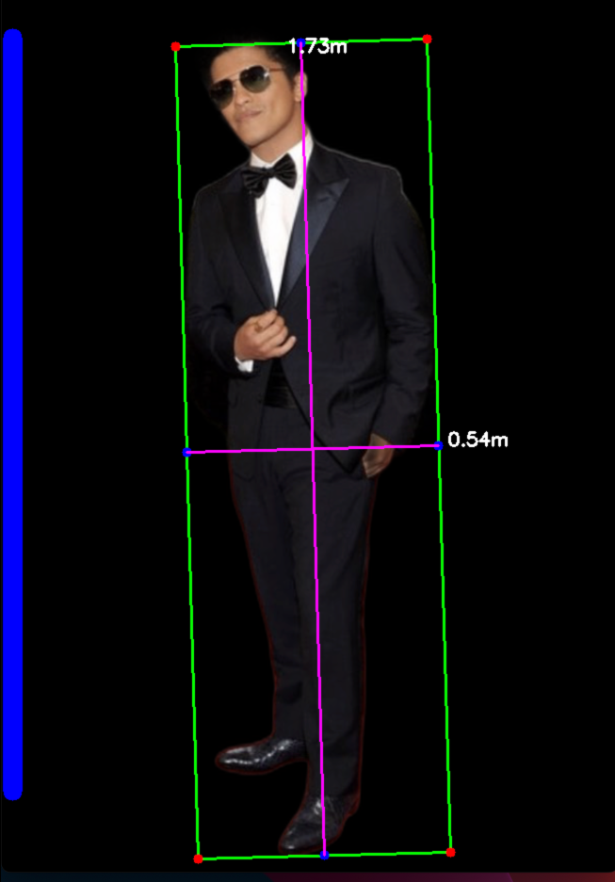
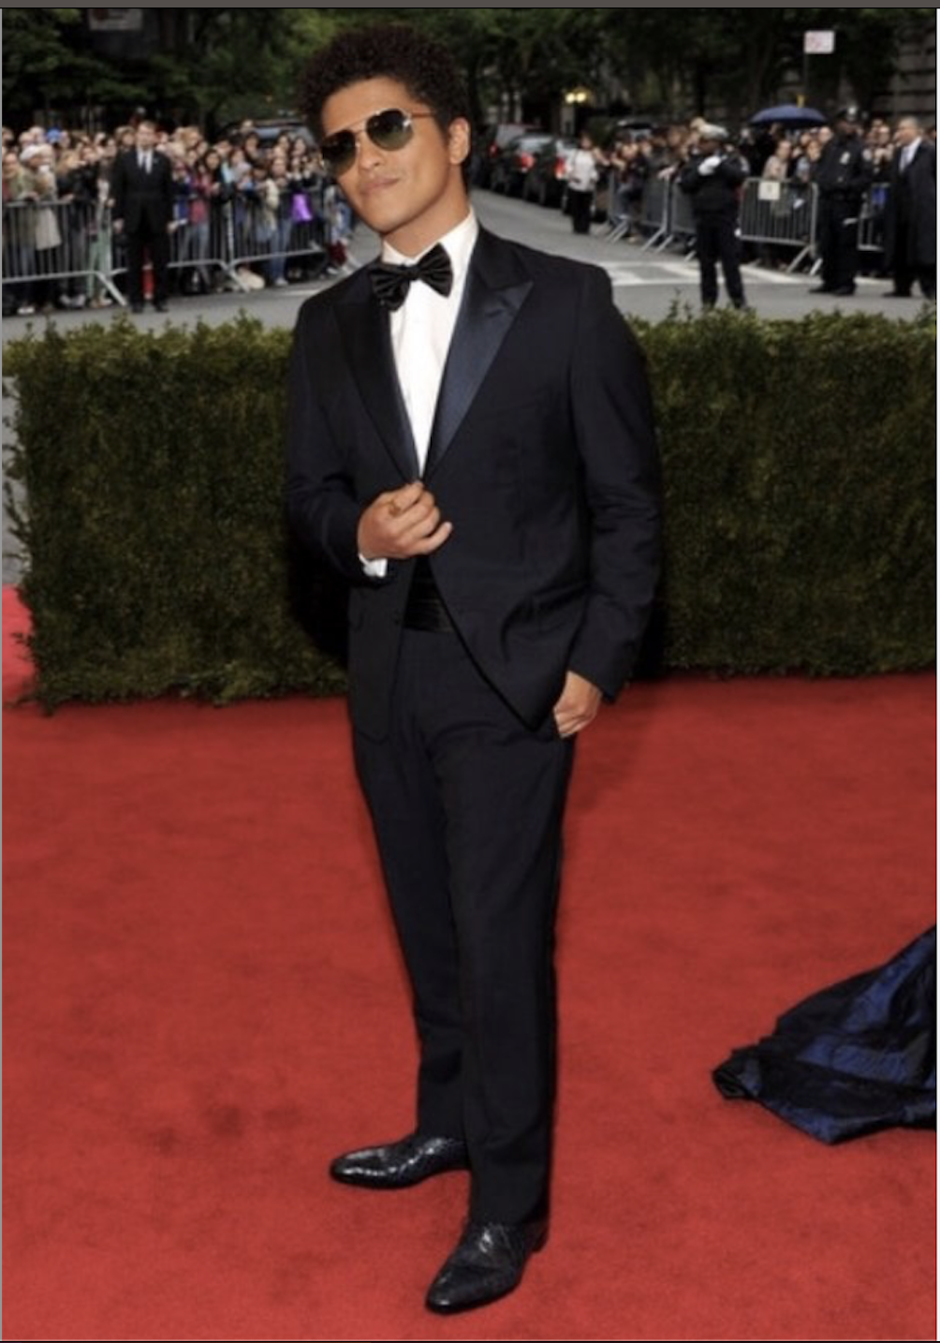
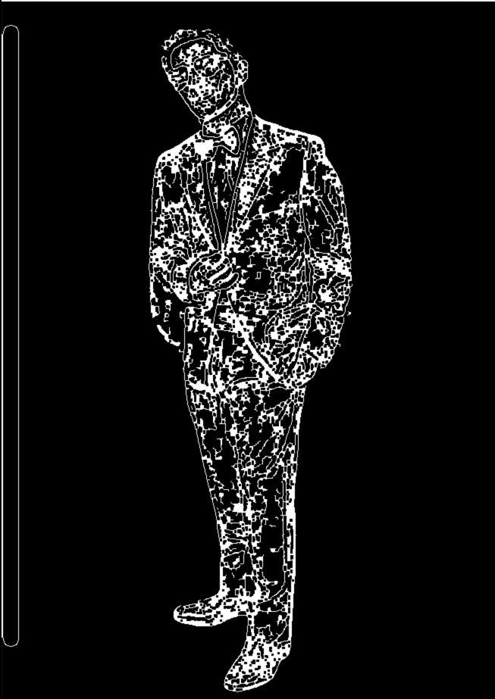
DEMO

Slide 6
Lessons Learnt
Became familiar with the Haar-Cascade Face Detection Algorithm.
Discovered KIVY
Discovered Rembg

Slide 7
Alterations That Could Be Made
Worked Faster
Create my own Human identification Algorithm.
Use a better technology to build UI

Slide 8
Future Plans
Use
Include
a field for you to enter your age and a validation check.
weigh by using a predictive algorithm.
a camera lens to calculate the user's height, weight, and result.
Check

Slide 9

Questions

